Slide 1
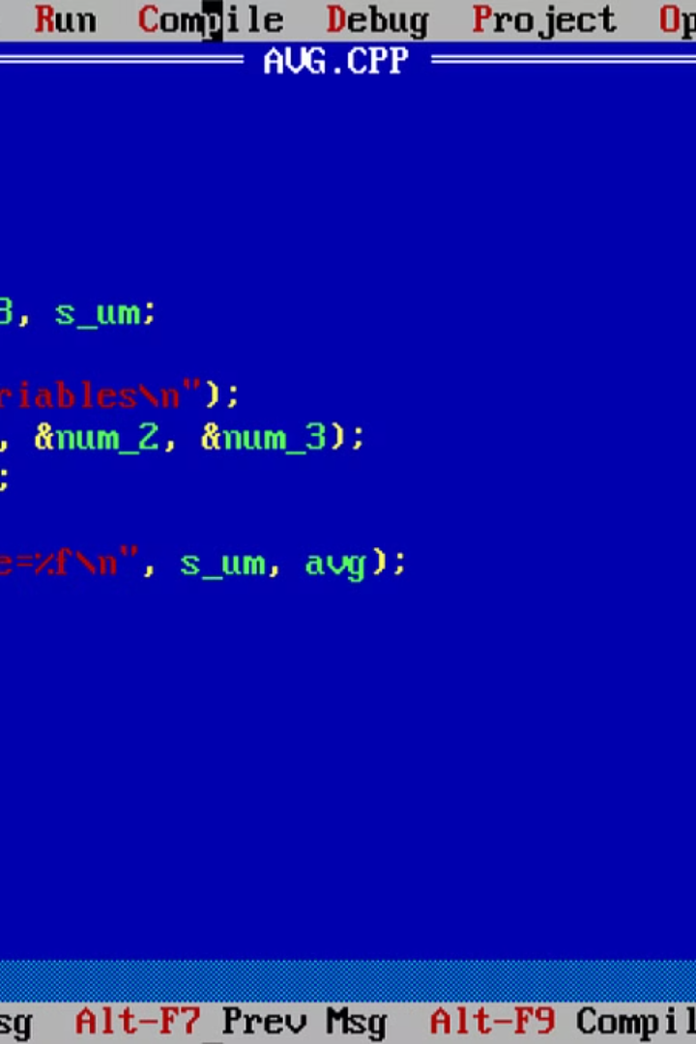
Introduction to File I/O in C
File Input/Output (I/O) in C is an essential concept for reading from and writing to files in the C programming language. It allows C programs to interact with external files for data storage and retrieval, making it a crucial aspect of file handling and data processing.
With file I/O, C programs can create, open, read, write, and close files, enabling the manipulation of data stored in external files. Understanding file I/O is fundamental for developing applications that require data persistence and management.

Slide 2

Opening a file in C
To open a file in C, you first need to declare a file pointer using the FILE data type.
Use the fopen() function, which takes the file name and the mode in which you want to open the file (read, write, append, etc.).
If the file doesn't exist, fopen() will create it. If it does exist, fopen() will simply open it.
Remember to check if the file was successfully opened by checking if the file pointer returned by fopen() is not NULL.

Slide 3

Reading from a File in C
When reading from a file in C, the first step is to open the file using the fopen() function. This function takes two parameters: the name of the file and the mode (e.g., "r" for reading). Once the file is opened successfully, data can be read using the fscanf() or fread() function, depending on whether the file is a text file or a binary file.
It's important to handle potential errors while reading from a file, such as reaching the end of the file or encountering a read error. Proper error handling ensures the reliability of the file I/O operations. After reading the necessary data, the file should be closed using the fclose() function to release system resources.
Open the file using fopen() with the appropriate mode
Read data from the file using fscanf() or fread()
Handle errors and ensure proper file closure

Slide 4

Writing to a File in C
When it comes to writing to a file in C, it's important to understand the process of opening a file, as well as the different modes in which you can open a file for writing.
Using the fopen function, you can open a file in write ("w") mode, which creates a new file for writing. There's also the append ("a") mode, which allows you to add new data to the end of an existing file without overwriting its contents. Additionally, you have the option to open a file exclusively for writing and create a new file if it doesn't exist with the "wx" mode.
Once the file is open, you can use functions like fwrite to write data to the file. Remember to close the file using fclose when you are done to ensure that all data is properly written and to release system resources associated with the file.

Slide 5

Closing a file in C
Once all the file operations are completed, it is important to properly close the file in C to release the resources associated with it. This prevents memory leaks and ensures that the data is safely stored in the file.
When closing a file in C, it's essential to check for any potential errors during the process. Proper error handling should be implemented to address any issues that may arise during the file closure, such as invalid file handles or permission errors.
Additionally, closing a file in C involves flushing any buffered data to the file to ensure that all changes are written before the file is closed. This guarantees that any pending data is written to the file and prevents data loss.

Slide 6

Error Handling in File I/O
When working with file I/O in C, it's crucial to implement robust error handling to anticipate and respond to potential issues. One common error is the failure to open a file, which can occur due to the file not existing, insufficient permissions, or other reasons. Additionally, errors may arise during reading from or writing to a file, such as reaching the end of the file unexpectedly or encountering a disk write error.
To handle these errors effectively, C provides mechanisms such as file error indicators and functions like perror() and strerror() to retrieve error messages. It's important to use these tools to inform the user about the nature of the error and gracefully handle exceptional conditions.
Furthermore, understanding and utilizing error codes returned by file I/O functions is essential for diagnosing and resolving issues. By diligently implementing error handling strategies, developers can ensure the reliability and stability of file operations within C programs.

Slide 7
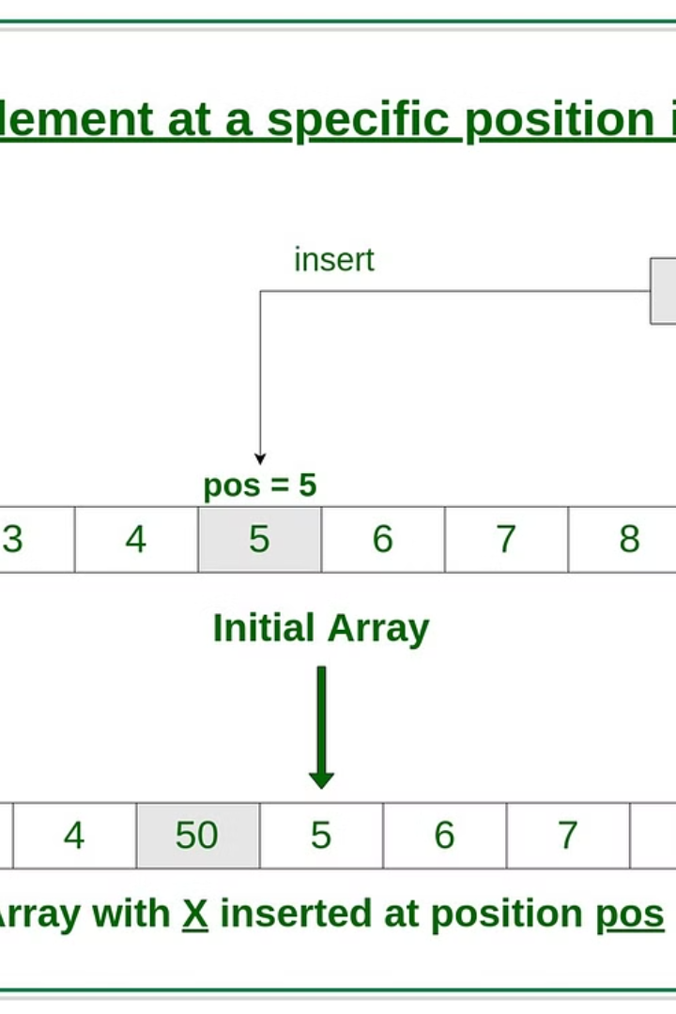
File Positioning in C
File positioning in C refers to the ability to set the current position within a file for reading or writing. In C, this is accomplished using functions such as fseek(), ftell(), and rewind(). These functions allow programmers to navigate within a file, read from specific locations, and write data at specific positions.
Understanding file positioning is crucial when working with large files or when there is a need to update specific parts of a file without rewriting the entire content. It also plays a key role in random access file handling, enabling efficient data retrieval and modification.
By mastering file positioning in C, developers can optimize file operations, improve efficiency, and ensure accurate data management within their programs.

Slide 8
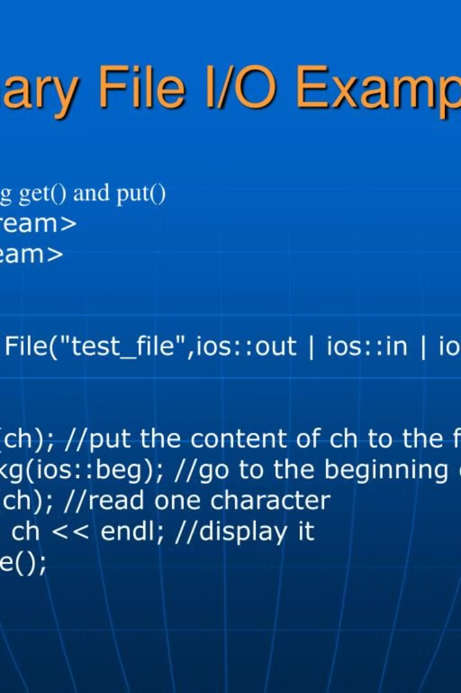
Binary file I/O in C
Binary file I/O in C involves working with binary files, which store data in a format that is directly readable by a computer. This type of file I/O is commonly used for storing and processing structured data, such as database records, images, and complex data structures.
When working with binary file I/O, developers need to understand concepts such as reading and writing binary data, handling file pointers, and dealing with binary file formats. Unlike text files, binary files are not human-readable, and special care must be taken when performing I/O operations on them.
Understanding binary file I/O is crucial for tasks such as reading and writing image files, processing multimedia data, and working with proprietary file formats. Additionally, efficient binary file I/O is essential for optimizing performance-critical applications and systems that handle large volumes of data.

Slide 9
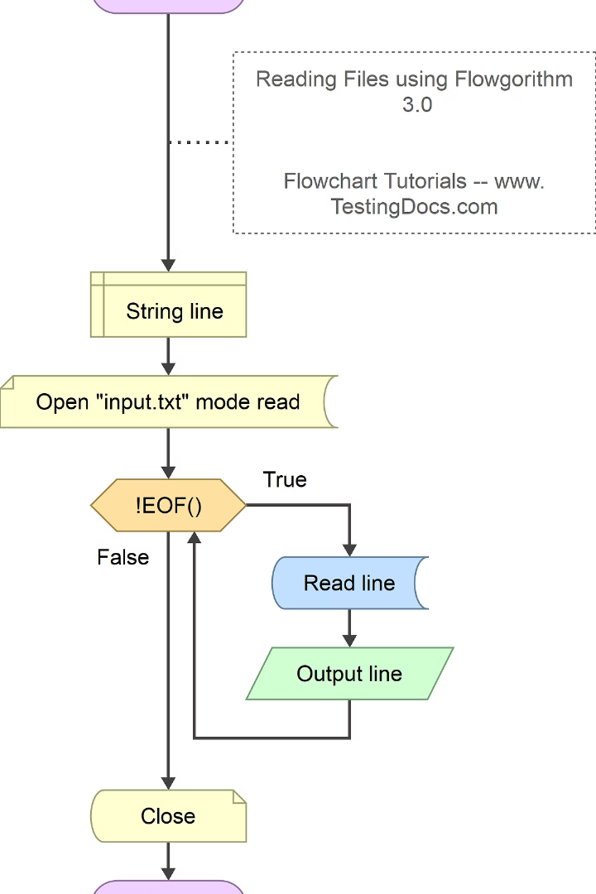
Text File I/O in C
Text file input/output (I/O) in C programming involves reading data from and writing data to text files. This is essential for handling text-based data, such as configuration files, logs, and user input/output in C applications.
When working with text file I/O in C, programmers use functions like fopen(), fclose(), fprintf(), and fscanf() to open, close, write, and read from text files, respectively. It's important to handle errors and exceptions that may occur during file operations to ensure robust and reliable file I/O.
Additionally, creating and writing to a new text file or appending data to an existing file are common tasks performed using text file I/O in C. Understanding file positioning and handling binary vs. text file I/O are also crucial aspects of working with text files in C programming.

Slide 10
Examples and Best Practices
1
Modular Code Structure
When writing code, it's essential to follow a modular structure. This involves breaking down the code into smaller, manageable parts, making it easier to read, understand, and maintain. By encapsulating specific functionalities into modules, it becomes simpler to debug, update, and reuse code. The modular approach also promotes better collaboration among developers, as different parts of a project can be worked on independently.
2
Error Handling and Logging
Effective error handling is a crucial aspect of robust software development. It's important to anticipate potential errors and handle them gracefully to prevent unexpected crashes. Additionally, implementing comprehensive logging mechanisms provides valuable insights into the behavior of the application and aids in troubleshooting issues. Best practices include using descriptive error messages, logging relevant details, and employing tools for centralized log management.
3
Version Control and Collaboration
Utilizing version control systems such as Git enables developers to track changes, collaborate seamlessly, and maintain a history of code modifications. Branching and merging capabilities facilitate concurrent work on different features or fixes, ensuring a cohesive and organized development process. Embracing a collaborative mindset, sharing knowledge, and actively participating in code reviews promotes a culture of continuous improvement and high-quality code delivery.

